Slide 1
DATA BASE MANAGEMENT SYSTEM

Slide 2
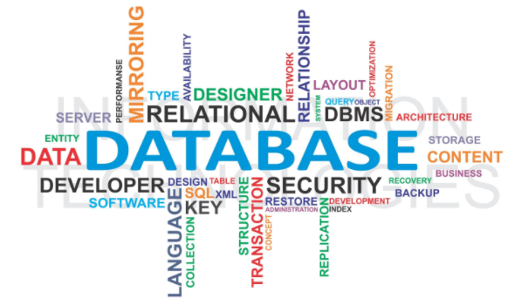
What is DATABASE ?
Database is a collection of inter – related
information ,which s stored in DBMS.

Slide 3
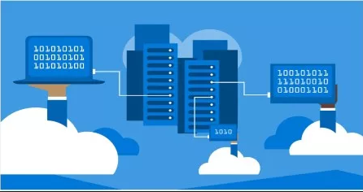
Need of DATA BASE
That interacts with the user, other applications, and the database itself to capture and analyze data.
A database management system (DBMS) is a computer software application.
A general-purpose DBMS’s designed to allow the definition, creation, querying, update, and administration of databases.

Slide 4
Data modeling
Hierarchical Databases
Network Database
Relational Database
File system
Object Database
History of DATABASE
Object Relational Database

Slide 5

DATA MODELING:-
Data modeling is the process of creating a data model for an information system by applying certain formal techniques.
FILE SYSTEM :-
A flat file database uses files to store simple information on a computer.
A UNIX or Linux operating system runs on a series of flat file databases.
A Windows computer also uses flat file databases to store information which is used every day.
Hierarchical Database:-
In this model each entity has only one parent but can have several children.
At the top of hierarchy there is only one entity which is called Root.

Slide 6

NETWORK DATABASE:-
In the network model, entities are organized in a graph, in which some entities can be accessed through several paths.
In network model, the relationship can be defined using sets.
RELATIONAL DATABASE:-
A relational database is a collection of data items organized as a set of formally-described tables from which data can be accessed or reassembled in many different ways without having to reorganize the database tables.
OBJECT DATABASE:-
An object database is a database management system in which information is represented in the form of objects as used in object-oriented programming.
Object databases are different from relational databases which are table-oriented.
OBJECT RELATIONAL DATABASE:-
An object-relational database (ORD), or object-relational database management system (ORDBMS), is a database management system (DBMS) similar to a relational database, but with an object-oriented database model.
Objects, classes and inheritance are directly supported in database schemas and in the query language.

Slide 7
Disadvantages of file based approach
Database approach
File based approach
DATABASE CONCEPTS

Slide 8

FILE BASED APPROACH:-
The term has generally implied a small, simple database.
As computer memory has become cheaper, more sophisticated databases can now be entirely held in memory for faster access.
These newer databases would not generally be referred to as
flat-file databases.
DISADVANTAGES OF FILE BASED APPROACH:-
Data Redundancy:
Data Inconsistency:
Difficulty in Accessing Data:
Limited Data Sharing:
Integrity Problems
DATABASE APPROACH:-
Main Characteristics of the Database Approach. Self-describing nature of a database system: A DBMS catalog stores the description of the database. The description is called meta-data. This allows the DBMS software to work with different databases. Insulation between programs and data: Called program-data independence.

Slide 9
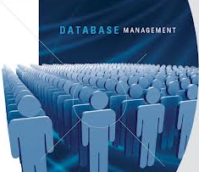
DATABASE MANAGEMANT SYSTEM
A database management system (DBMS) is system software for creating and managing databases.
The DBMS provides users and programmers with a systematic way to create, retrieve, update and manage data.

Slide 10

ADVANTAGES IN USING DBMS
Improved data sharing.
Improved data security.
Better data integration.
Minimized data inconsistency.
Improved data access.
Improved decision making.
Increased end-user productivity.
Increased costs

Slide 11

Functions of DBMS
A database management system is a software tool that makes it possible to organize data in a database.
It is often referred to by its acronym, DBMS.
The functions of a DBMS include concurrency, security, backup and recovery, integrity and data descriptions , indexing ,views , documentation.

Slide 12
ATOMICITY
ISOLATION
CONSISTENCY
DURABILITY
ACID Properties

Slide 13

A – Atomicity:
states a transaction is an indivisible unit that is either performed as a whole and not by its parts, or not performed at all. It is the responsibility of recovery management to make sure this takes place.
C – Consistency:
A transaction must alter the database from one constant state to another constant state.
I – Isolation:
Transactions must be executed independently of one another . Part of a transaction in progress should not be able to be seen by another transaction.
D – Durability:
A successfully completed transaction is recorded permanently in the database and must not be lost due to failures.

Slide 14
TERMINOLOGIES
Cardinality
Relational Database
Entity
Attribute
Domain
Tuple
Degree

Slide 15

Entity:-
Entity are principle data objects about which information is to be collected.
Attribute
Single valued Attributes :
An attribute, that has a single value for a particular entity is known as single valued attributes. For example, age of a employee entity.
Multi valued Attributes :
An attributes that may have multiple values for the same entity is known as multi valued attributes. For example colors of a car entity.
Compound Attribute/Composite Attribute :
Attribute can be subdivided into two or more other Attribute. For Example, Name can be divided into First name, Middle name and Last name.
Derived Attribute :
Attributes derived from other stored attribute. For example age from Date of Birth and Today’s date.

Slide 16

Tuple:-
A row in the table is called a tuple.
Number of columns in the relation is called Degree.
Number of tuples is called Cardinality.
Relational Database:-
A relational database is a collection of data items organized as a set of formally-described tables from which data can be accessed or reassembled in many different ways without having to reorganize the database tables.
Domain:-

Slide 17

Entity:-
Entity are principle data objects about which information is to be collected.
Degree:-
Number of columns in the relation is called Degree.
Cardinality:-

Slide 18

RDBMS
A relational database management system (RDBMS) is a database management system (DBMS) based on the relational model.

Slide 19
Differences between DBMS & RDBMS
DBMS
RDBMS
A DBMS is a storage area that persist the data in files. To perform the database operations, the file should be in use.
- Relationship can be established between 2 files.
- There are limitations to store records in a single database file depending upon the database manager used
. - DBMS allows the relations to be established between 2 files. - Data is stored in flat files with metadata.
- DBMS does not support client / server architecture.
- DBMS does not follow normalization. Only single user can access the data.
- DBMS does not impose integrity constraints.
- ACID properties of database must be implemented by the user or the developer.
RDBMS stores the data in tabular form.
- It has additional condition for supporting tabular structure or data that enforces relationships among tables.
. - RDBMS supports client/server architecture.
- RDBMS follows normalization.
- RDBMS allows simultaneous access of users to data tables. - RDBMS imposes integrity constraints.
- ACID properties of the database are defined in the integrity constraints.

Slide 20

TABLE:-
A table is a collection of related data held in a structured format within a database.
It consists of columns, and rows.
FIELD:-
Data that has several parts, known as a record, can be divided into fields.
Relational databases arrange data as sets of database records, also called rows.
Each record consists of several fields; the fields of all records form the columns. Examples of fields: name, gender, hair color.
ROW:-
In the context of a relational database, a row—also called a record or tuple—represents a single, implicitly structured data item in a table.

Slide 21

COLUMN:-
In a relational database, a column is a set of data values of a particular simple type, one value for each row of the database.
A column may contain text values, numbers, or even pointers to files in the operating system.
NULL VALUE:-
In databases a common issue is what value or placeholder do you use to represent a missing values.
In SQL, this is solved with null. It is used to signify missing or unknown values.
The keyword NULL is used to indicate these values.

Slide 22

Entity Relationship
Modeling
An entity relationship diagram (ERD), also known as an entity relationship model, is a graphical representation of an information system that depicts the relationships among people, objects, places, concepts or events within that system. An ERD is a data modeling technique that can help define business processes and be used as the foundation for a relational database.

Slide 23

Relationship
Relationship defines how two tables are linked to each other.

Slide 24
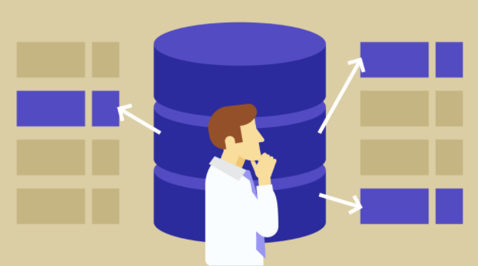
Relationship Types
One-to-one: Both tables can have only one record on either side of the relationship. Each primary key value relates to only one (or no) record in the related table. They're like spouses—you may or may not be married, but if you are, both you and your spouse have only one spouse. Most one-to-one relationships are forced by business rules and don't flow naturally from the data. In the absence of such a rule, you can usually combine both tables into one table without breaking any normalization rules.
One-to-many: The primary key table contains only one record that relates to none, one, or many records in the related table. This relationship is similar to the one between you and a parent. You have only one mother, but your mother may have several children.
Many-to-many: Each record in both tables can relate to any number of records (or no records) in the other table. For instance, if you have several siblings, so do your siblings (have many siblings).Many-to-many relationships require a third table, known as an associate or linking table, because relational systems can't directly accommodate the relationship.

Slide 25

Constraints
Constraints enforce limits to the data or type of data that can be inserted/updated/deleted from a table.
The whole purpose of constraints is to maintain the data integrity during an update/delete/insert into a table.
In this tutorial we will learn several types of constraints that can be created in RDBMS

Slide 26

Primary key & Foreign key
PRIMARY KEY:
Primary key uniquely identifies each record in a table. It must have unique values and cannot contain nulls. In the below example the ROLL_NO field is marked as primary key, that means the ROLL_NO field cannot have duplicate and null values. CREATE TABLE STUDENT( ROLL_NO INT NOT NULL, STU_NAME VARCHAR (35) NOT NULL UNIQUE, STU_AGE INT NOT NULL, STU_ADDRESS VARCHAR (35) UNIQUE, PRIMARY KEY (ROLL_NO)
FOREIGN KEY:
Foreign keys are the columns of a table that points to the primary key of another table. They act as a cross-reference between tables.

Slide 27

Data Integrity

Slide 28

EF Rules

Slide 29
Rule 1: The information rule: All
information in the database is to be represented in one and only one way, namely by values in column positions within rows of tables.
Rule 2: The guaranteed access rule: All data must be accessible. This rule is essentially a restatement of the fundamental requirement for primary keys. It says that every individual scalar value in the database must be logically addressable by specifying the name of the containing table, the name of the containing column and the primary key value of the containing row.
Rule 3: Systematic treatment of null values: The DBMS must allow each field to remain null (or empty). Specifically, it must support a representation of "missing information and inapplicable information" that is systematic, distinct from all regular values (for example, "distinct from zero or any other number", in the case of numeric values), and independent of data type. It is also implied that such representations must be manipulated by the DBMS in a systematic way.

Slide 30
Rule 4: Active online catalog based on the relational model: The system must support an online, inline, relational catalog that is accessible to authorized users by means of their regular query language. That is, users must be able to access the database's structure (catalog) using the same query language that they use to access the database's data.
Rule 5: The comprehensive data sub language rule: The system must support at least one relational language that 1. Has a linear syntax 2. Can be used both interactively and within application programs, 3. Supports data definition operations (including view definitions), data manipulation operations (update as well as retrieval), security and integrity constraints, and transaction management operations (begin, commit, and rollback).
Rule 6: The view updating rule: All views those can be updated theoretically, must be updated by the system.

Slide 31
Rule 7: High-level insert, update, and delete: The system must support set-at-a-time insert, update, and delete operators. This means that data can be retrieved from a relational database in sets constructed of data from multiple rows and/or multiple tables. This rule states that insert, update, and delete operations should be supported for any retrievable set rather than just for a single row in a single table.
Rule 8: Physical data independence: Changes to the physical level (how the data is stored, whether in arrays or linked lists etc.) must not require a change to an application based on the structure.
Rule 9: Logical data independence: Changes to the logical level (tables, columns, rows, and so on) must not require a change to an application based on the structure. Logical data independence is more difficult to achieve than physical data independence.

Slide 32
Rule 10: Integrity independence: Integrity constraints must be
specified separately from application programs and stored in the catalog. It must be possible to change such constraints as and when appropriate without unnecessarily affecting existing applications.
Rule 11: Distribution independence: The distribution of portions of the database to various locations should be invisible to users of the database. Existing applications should continue to operate successfully: 1. When a distributed version of the DBMS is first introduced; and 2. When existing distributed data are redistributed around the system.
Rule 12: The non subversion rule: If the system provides a low-level (record-at-a-time) interface, then that interface cannot be used to subvert the system, for example, bypassing a relational security or integrity constraint.

Slide 33

NORMALIZATION

Slide 34

Normalization
Normalization of Database Normalization is a technique of organizing the data in the database.
Normalization is a systematic approach of decomposing tables to eliminate data redundancy and undesirable characteristics like Insertion, Update and Deletion anamolies.
It is a multi-step process that puts data into tabular form by removing duplicated data from the relation tables. Normalization is used for mainly two purpose.
• Eliminating reduntant (useless) data.
• Ensuring data dependencies make sense i.e data is logically stored
Problem Without Normalization Without Normalization, it becomes difficult to handle and update the database, without facing data loss. Insertion, Updation and Deletion Anamolies are very frequent if Database is not Normalized.
To understand these anomalies let us take an example of Student table. S_ id S_ Name S_ Address Subject_opted
401 Adam Noida Bio
402 Alex Panipat Maths
403 Stuart Jammu Maths
404 Adam Noida Physics

Slide 35

Normalization Rule
Normalization rule are divided into following normal form.
1. First Normal Form
2. Second Normal Form
3. Third Normal Form
4. BCN

